Slide 1

Visual Relationship Detection
一文带你畅游视觉关系检测(Visual Relationship Detection)
https://www.jianshu.com/p/6d6132113fa5

Slide 2

ProBlem

Slide 3
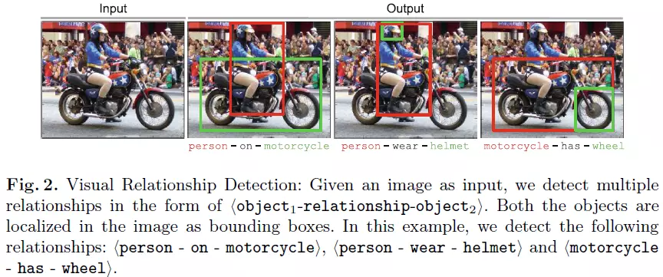
Problem
Rel: <object1 - predicate - object1>
关系可以是空间关系（above，next to，below），动词verb（wear），介词（with），比较（taller than）等等。

Slide 4
应用
视觉关系识别是图像理解的基础，可以应用在
物体检测——利用物体间的关系，所处场景来提高物体检测的准确率；
Image Captioning——图像描述中往往就包含着物体之间的关系的描述，如一个人骑着摩托；
VQA（Visual Question Answer）——视觉问答的一些问题中也是会包含着物体关系的问题，如桌子上面的是什么？；
Image Retrieval——图像检索任务也会根据自然语言描述或者图像来检索相关的图像；
Image Generation——根据自然语言来生成图像的任务中需要理解自然语言中的物体，以及物体之间的关系，才能更好的生成符合描述的图像；
等等

Slide 5
挑战
需要学习的关系，元组数量多——假设对象类型有N类，关系有R种，那么元组类型就会有NRN种（所以一般对象和关系会分开学习，这样学习的就大大减少了）；
同一个关系的视觉外观差别很大，如ride，骑马，骑单车；
有些relation元组是比较罕见的，或者数量巨大，所以有一些关系元组是不会出现在训练集中，这时候就需要模型能够有迁移拓展的能力(zero-shot)；

Slide 6
纵览

Slide 7
Research
Visual Relationship Detection with Language Priors, Cewu Lu, et.al, ECCV 2016
Visual Translation Embedding Network for Visual Relation Detection, Hanwang Zhang, et.al, CVPR 2017
Representation Learning for Scene Graph Completion via Jointly Structural and Visual Embedding, Hai Wan, et.al, IJCAI 2018
Scene Graph Generation by Iterative Message Passing, Danfei Xu, et.al., CVPR 2017
Tensorize, Factorize and Regularize: Robust Visual Relationship Learning, Seong Jae Hwang, et.al., CVPR 2018
Structure Inference Net: Object Detection Using Scene-Level Context and Instance-Level Relationships, Yong Liu, et.al., CVPR 2018
Referring Relationships, Ranjay Krishna, et.al., CVPR 2018
Image Generation from Scene Graphs, Justin Johnson, et.al., CVPR 2018
R-VQA: Learning Visual Relation Facts with Semantic Attention for Visual Question Answering, Pan Lu, et.al., Arxiv
Exploring Visual Relationship for Image Captioning, ECCV 2018
Zoom-Net: Mining Deep Feature Interactions for Visual Relationship Recognition, ECCV 2018

Slide 8
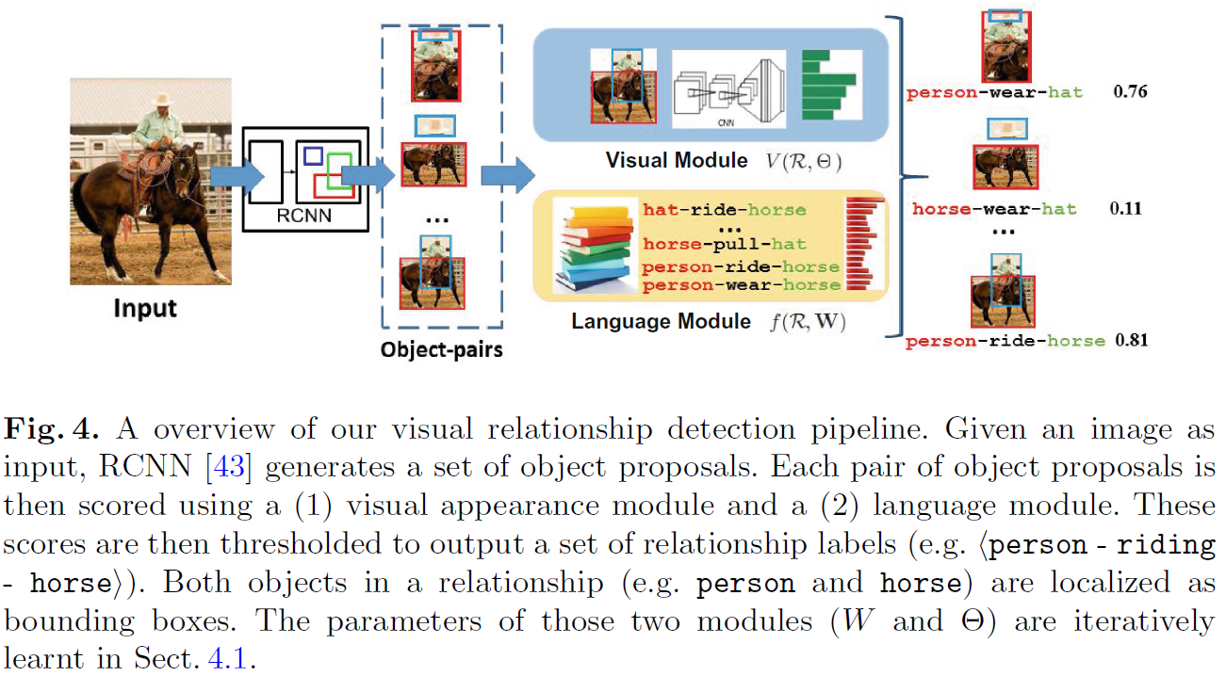
Visual Relationship Detection with Language Priors
结合Prior：word embedding， Tensorize，语料库

Slide 9
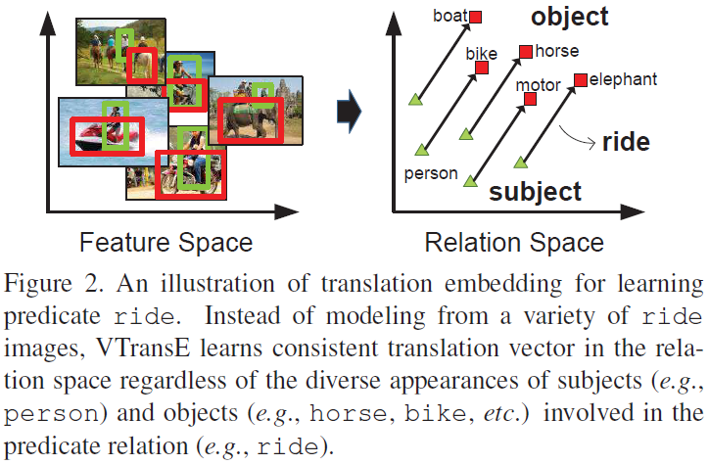
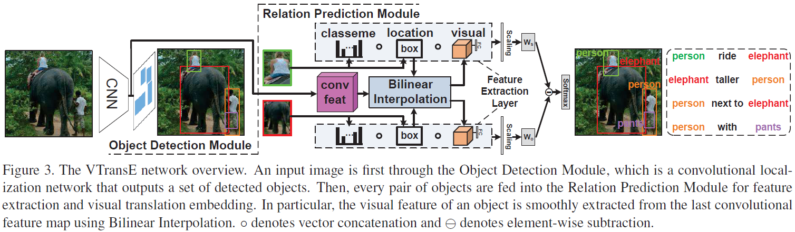
Visual Translation Embedding Network for Visual Relation Detection
利用知识图谱的Trans方法

Slide 10
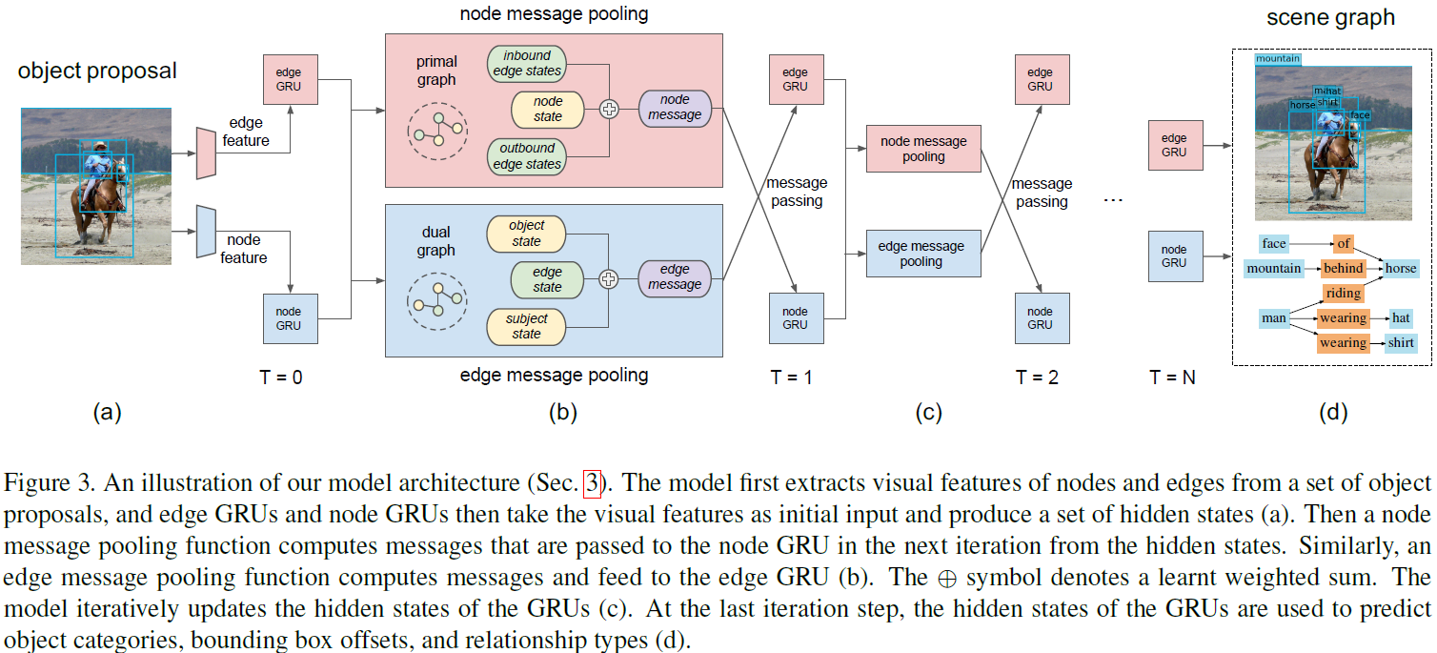
Scene Graph Generation by Iterative Message Passing

Slide 11
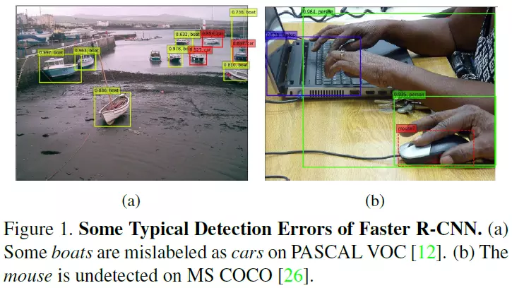
Structure Inference Net: Object Detection Using Scene-Level Context and Instance-Level Relationships
用于目标检测（利用object的共现关系，局部和全局的上下文信息）

Slide 12
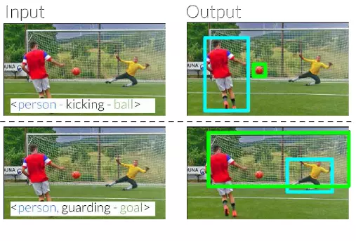
Referring Relationships, Ranjay Krishna, et.al., CVPR 2018
消歧义

Slide 13
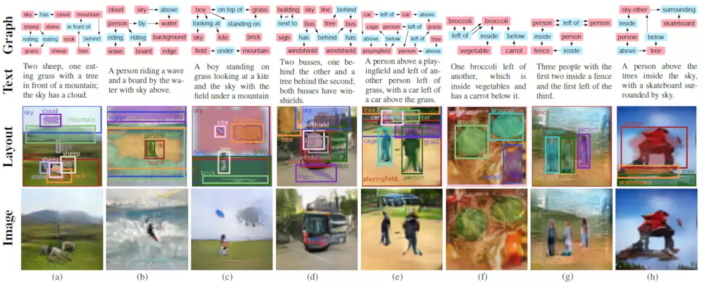
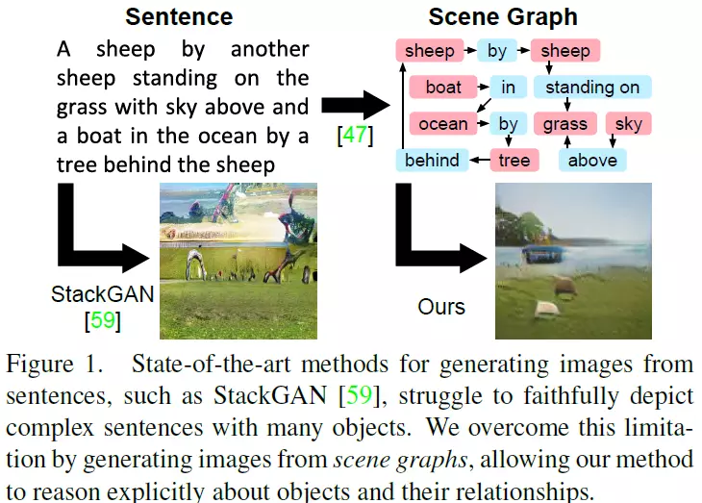
Image Generation from Scene Graphs
图像生成

Slide 14

Zoom-Net: Mining Deep Feature Interactions for Visual Relationship Recognition, ECCV 2018

Slide 15
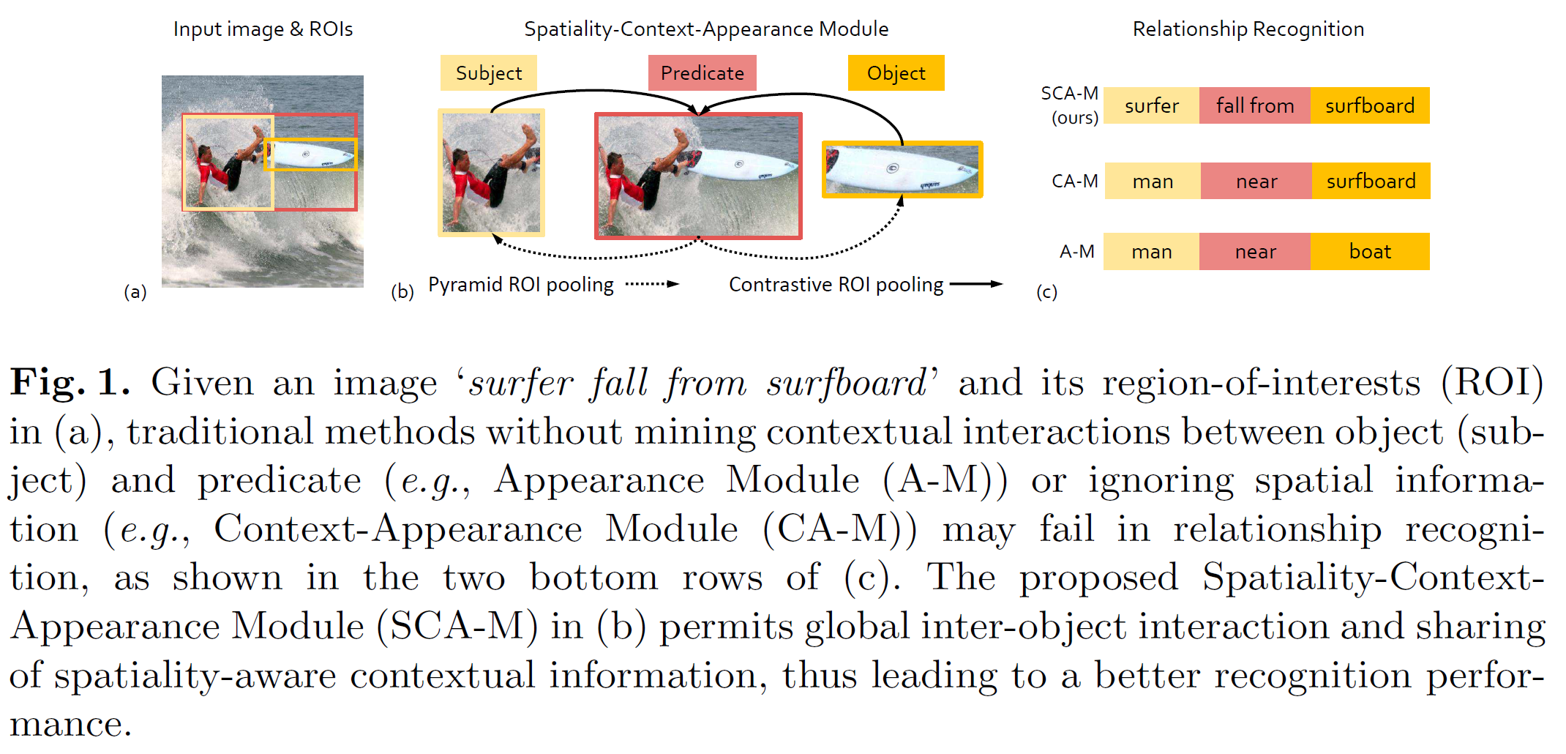
Deep feature interaction

Slide 16
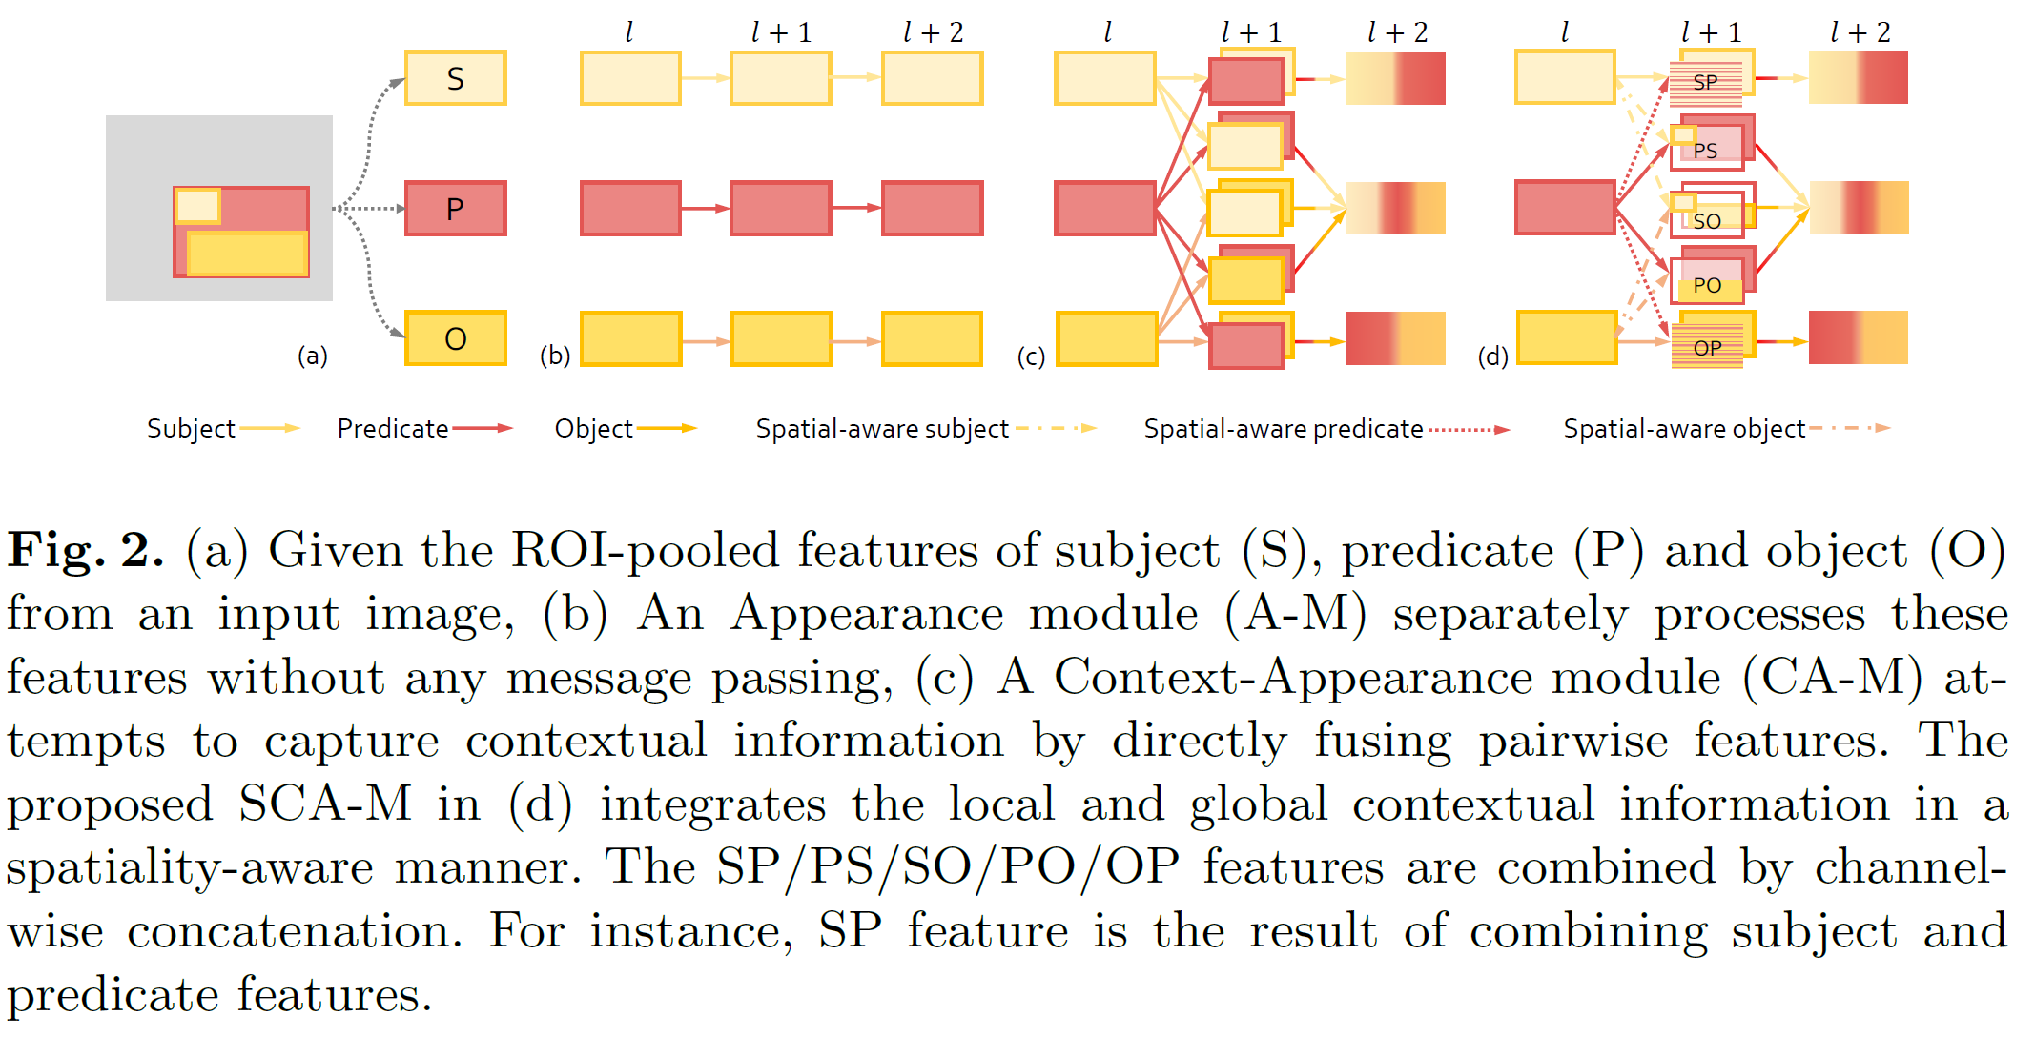
Appearance, Context, Spatial

Slide 17
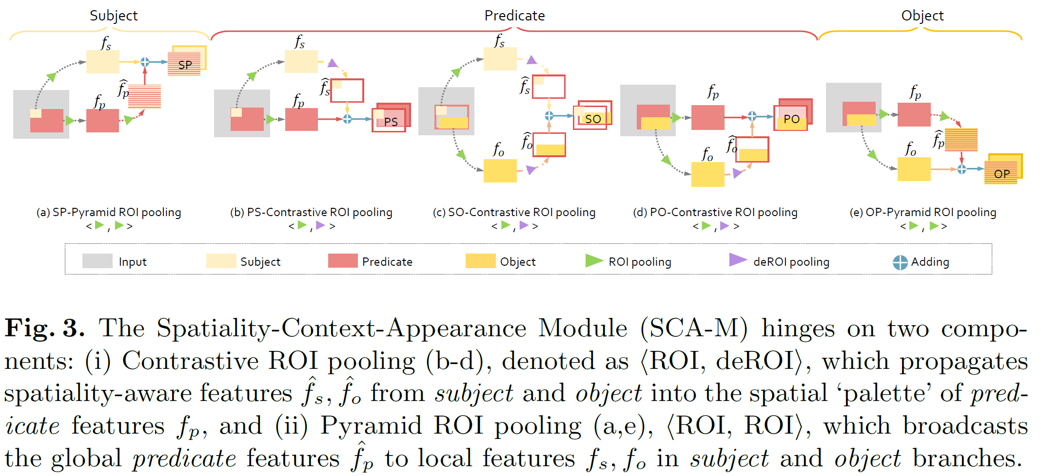
SCA-Module

Slide 18
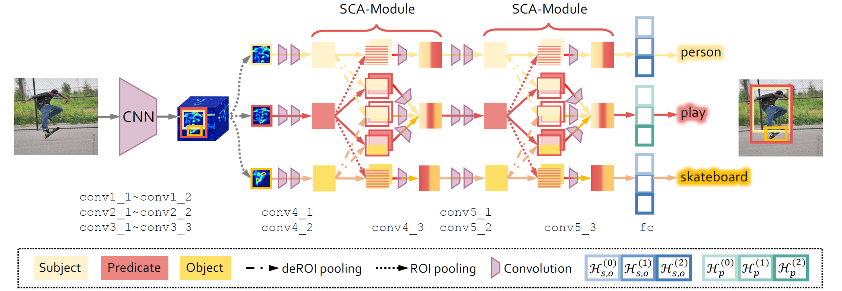
Stacked

Slide 19
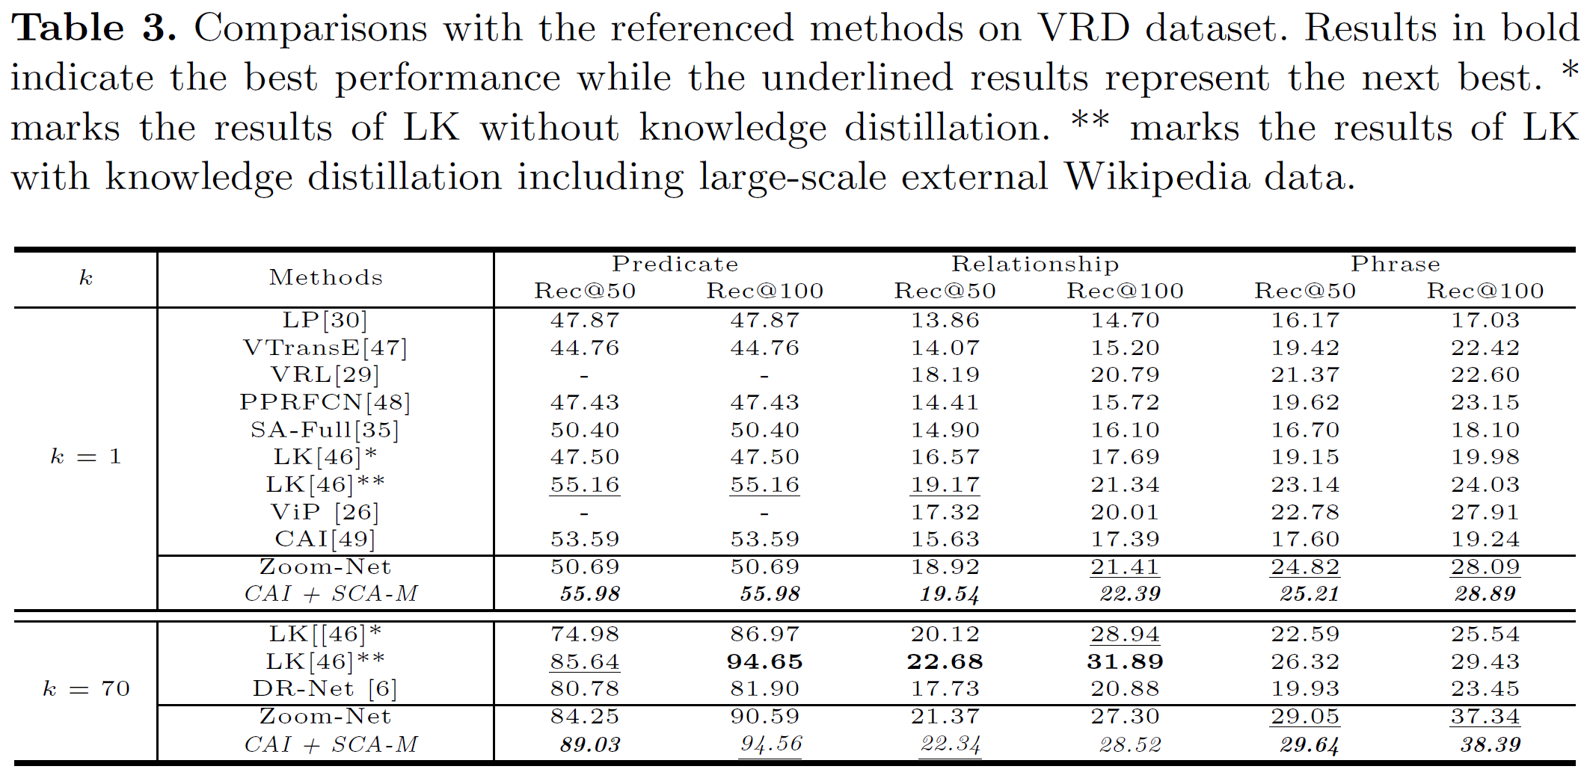
Result

Slide 20
What to do

Slide 21
Spatial, Rel importance
Subject
Object
Weight of Rel Importance
position_{s}
-
position_{o}
Scene
Predicate
Relative position
Attention
Subject, object embedding
Predicate

Slide 22

Thanks for your Listening

